Slide 1
Analysis of existing curricula related to WRM in both EU and WB partner countries
– WP1.3
DI Kurt Glock
University of Natural Resources and Life Sciences BOKU, Vienna
Meeting / 9th May 2019
This project has been funded with support from the European Commission. This publication reflects the views only of the author, and the Commission cannot be held responsible for any use which may be made of the information contained therein.

Slide 2
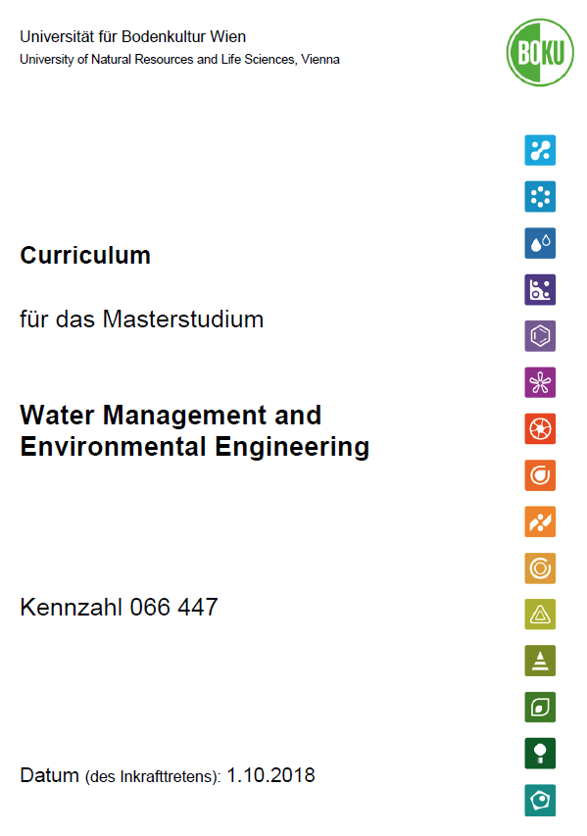
1.3 Analysis of existing curricula related to WRM in both EU and WB partner countries
Comparative analysis of structure and model of EU/WB curricula
Definition of needs of existing study programmes
List of EU curricula (Catalogue of Courses) including teaching methods and laboratory equipment
© BOKU, 2018

Slide 3
Overview of master curricula in EU partner HEI
Nation | Number of master´s degree programmes | Universities
Austria | 5 | University of Natural Resources and Life Sciences Vienna, BOKU (2) Graz University of Technology, TU Graz Vienna University of Technology, TU Wien University of Innsbruck, UIBK
Bulgaria | 6 | University of Architecture, Civil Engineering and Geodesy, Sofia (4) Varna Free University “Chernorizets Hrabar” Sofia University “St. Kliment Ohridski”
Croatia | 4 | University of Rijeka, Faculty of Civil Engineering University of Zagreb, Faculty of Civil Engineering University of Split, Faculty of Civil Engineering, Architecture and Geodesy Josip Juraj Strossmayer University in Osijek, Faculty of Civil Engineering and Architecture
Greece | 5 | National Technical University of Athens, Dept. of Civil Engineering University of Thrace, Dept. of Civil Engineering Department of Forestry and Natural Environment Management, Eastern Macedonia and Thrace Institute of Technology (EMATECH) Technical University of Crete, School of Environmental Engineering Aristotle University of Thessaloniki, School of Civil Engineering
Norway | 5 | Norwegian University of Science and Technology Norwegian University of Life Sciences University of Bergen University of Oslo University of Stavanger
Portugal | 8 | Universidade de Lisboa, Instituto Superior Técnico (2) Faculdade de Engenharia, Universidade do Porto (2) Faculdade de Ciências e Tecnologia, Universidade de Coimbra (2) Faculdade de Ciências e Tecnologia, Universidade Nova de Lisboa (2)
Total: | 33
46.7 Mio inhabitants
~1.4 Mio inhabitants per master programme

Slide 4
Overview of master curricula in WB partner HEI
Nation | Number of master´s degree programmes | Universities
Bosnia and Herzegovina | 2 | University of Mostar University of Sarajevo
Kosovo* | 1 | University of Pristina in Kosovska Mitrovica
Montenegro | 1 | University of Montenegro
Serbia | 3 | University of Belgrade University of Nis University of Novi Sad
Total: | 7
12.9 Mio inhabitants
~1.8 Mio inhabitants per master programme
No need for new master curricula,
BUT (maybe) strengthening of existing ones
→ SWARM

Slide 5
Comparative analysis of structure and model of EU/WB curricula
Comparison is quite difficult → Different education systems
3 years Bachelor + 2 years Master
4 year education + 1 year Master
High schools
Research colleges
Etc.
Same overall goal of educated Water Resources Managers

Slide 6
Definition of needs of existing study programmes
Lack of water-related courses in curricula
Basic education (Bachelor) versus specialisation (Master) → increased offer of courses/modules (e.g.: Project management for hydraulic engineering, sediment management, consideration of aquatic ecology, etc.)
Strengthening of practical and/or laboratory exercises
Improved education material (e.g.: Laboratory equipment, software, etc.)
??

Slide 7
Contact information
University of Natural Resources and Life Sciences Vienna (BOKU)
Department of Water, Atmosphere and Environment (WAU)
Institute of Hydraulic Engineering and River Research (IWA)
Find more about us in
http://www.wau.boku.ac.at/en/
Kurt Glock
Dipl.-Ing.
E-mail: kurt.glock@boku.ac.at
Michael Tritthart
Priv.-Doz. Dipl.-Ing. Dr.techn.
E-mail: michael.tritthart@boku.ac.at

